Slide 1







Stack Overflow Technology Trends Analysis in 2019
DIN MOHAMMAD DOHAN
3rd February, 2024

Slide 2



OUTLINE
Executive Summary
Introduction
Methodology
Results
Visualization – Charts
Dashboard
Discussion
Findings & Implications
Conclusion
Appendix

Slide 3

EXECUTIVE SUMMARY
JavaScript, Python, HTML/CSS, SQL, and TypeScript are the most desirable programming languages for next year.
PostgreSQL, MongoDB, Redis, MySQL, and ElasticSearch are the most desirable databases for next year.
Gender gap in the IT industry.
Male = 93.7%
Female = 6.3%

Slide 4

INTRODUCTION
Stack Overflow, a popular website for developers, conducted a survey amongst developers from around the world about technology trends in 2019.
Programming Languages
Databases
Demographics
Target audience:
IT professionals
Anyone interested in the IT field

Slide 5

METHODOLOGY
Data Sources:
Stack Overflow Developers Survey 2019
Github Job Posting
Programming Language Annual Salary
Data Exploration and Cleaning
Python
Data Visualization
IBM Cognos Analytics
Presentation

Slide 6
RESULTS
The results consists of 4 main parts:
Programming language trend
Database trend
Platform trend
Web frame trend

Slide 7
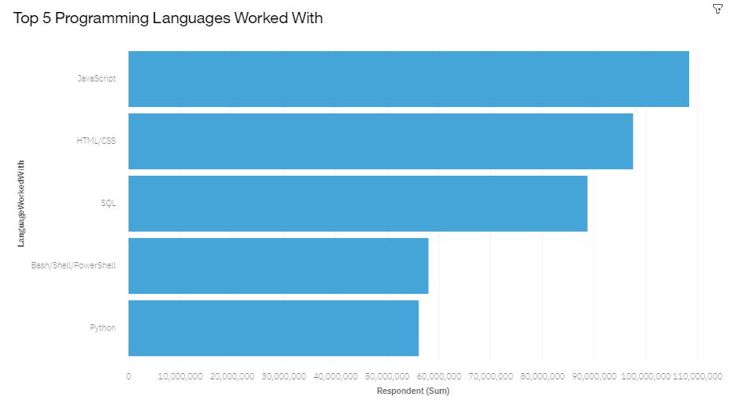
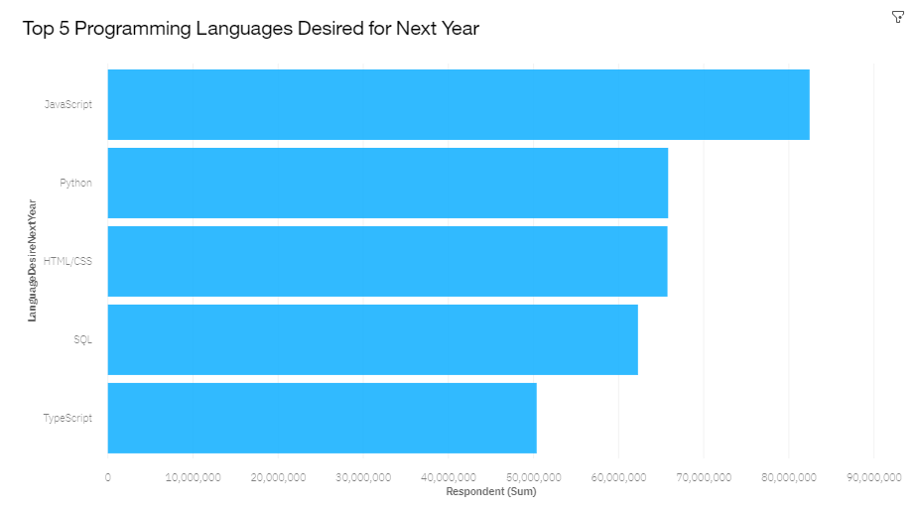
PROGRAMMING LANGUAGE TRENDS
Current Year
Next Year
<Bar chart of top 10 programming languages for the current year goes here.>
< Bar chart of top 10 programming languages for the next year goes here.>

Slide 8
PROGRAMMING LANGUAGE TRENDS - FINDINGS & IMPLICATIONS
Findings
JavaScript is the most in demand programming language.
Python, HTML/CSS, and SQL are other in demand programming languages.
Skills in TypeScript is more desirable than Bash/Shell/PowerShell for next year.
Implications
Python’s increase in demand may overtake JavaScript in the future.
JavaScript, Python, HTML/CSS, and SQL are consistently in demand.
Web development remains in high demand.

Slide 9
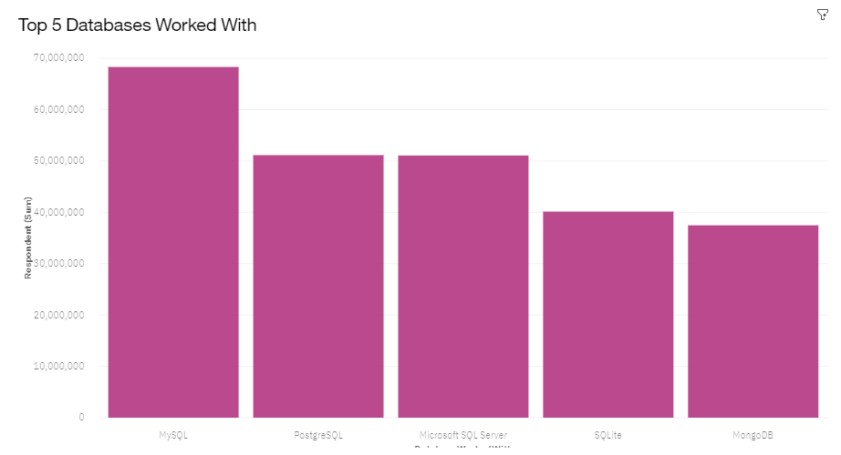
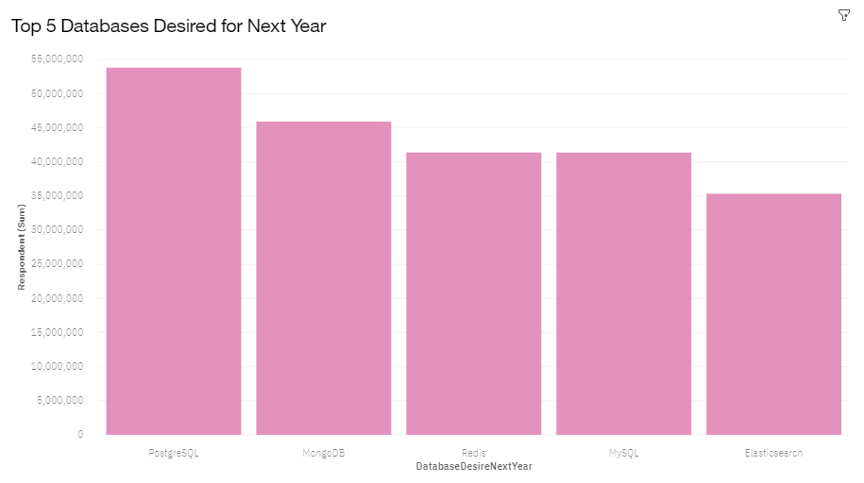
DATABASE TRENDS
Current Year
Next Year
< Bar chart of top 10 databases for the current year goes here >
< Bar chart of top 10 databases for the next year goes here.>

Slide 10
DATABASE TRENDS - FINDINGS & IMPLICATIONS
Findings
PostgreSQL and MongoDB have an increase in demand.
MySQL has a decrease in demand for next year.
Skills in Redis and ElasticSearch are more desirable than Microsoft SQL Server and SQLite for next year.
Implications
PostgreSQL and MongoDB are the most consistent in demand databases.
Open source databases are preferred.
Demand is volatile.

Slide 11
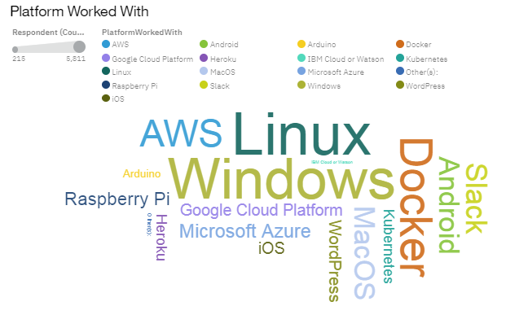
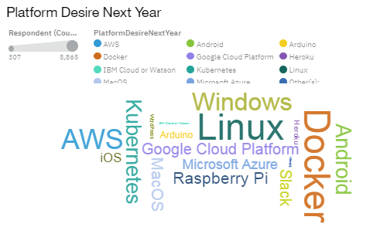
PLATFORM TRENDS
Current Year
Next Year

Slide 12
PLATFORM TRENDS - FINDINGS & IMPLICATIONS
Findings
Windows and Linux still dominates the platform trend.
Android is No.1 in mobile platform.
Cloud platform such as Kubernetes, Docker, AWS is getting more and more market share.
Implications
Windows and Linux are still main developing platform in a foreseeable future.
The transformation to cloud computing is a non-reversible process.

Slide 13
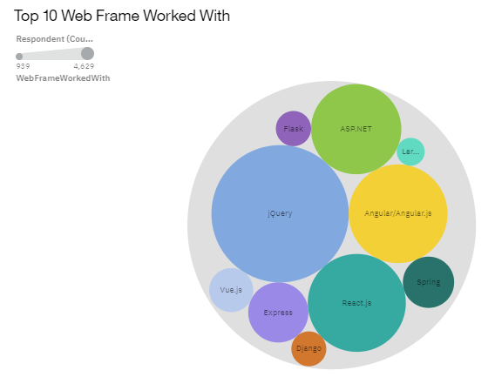
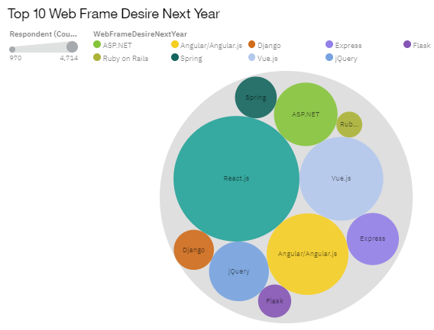
WEB FRAME TRENDS
Current Year
Next Year

Slide 14
WEB FRAME TRENDS - FINDINGS & IMPLICATIONS
Findings
jQuery decreases from No.1 to No.4.
React.js moves up from No.3 to No.1
Vue.js moves from No.9 to No.3.
Angular.js stays at same position.
Implications
jQuery quickly loses market share show lack of interest in its future development.
React.js and Vue.js becomes the new standard for web frame development.

Slide 15

GITHUB REPOSITORY
GitHub Repository Name: IBM Data Analyst Capstone Project
Link: https://github.com/DinMohammadDohan/IBM-DataAnalyst-Capstone-Project

Slide 16
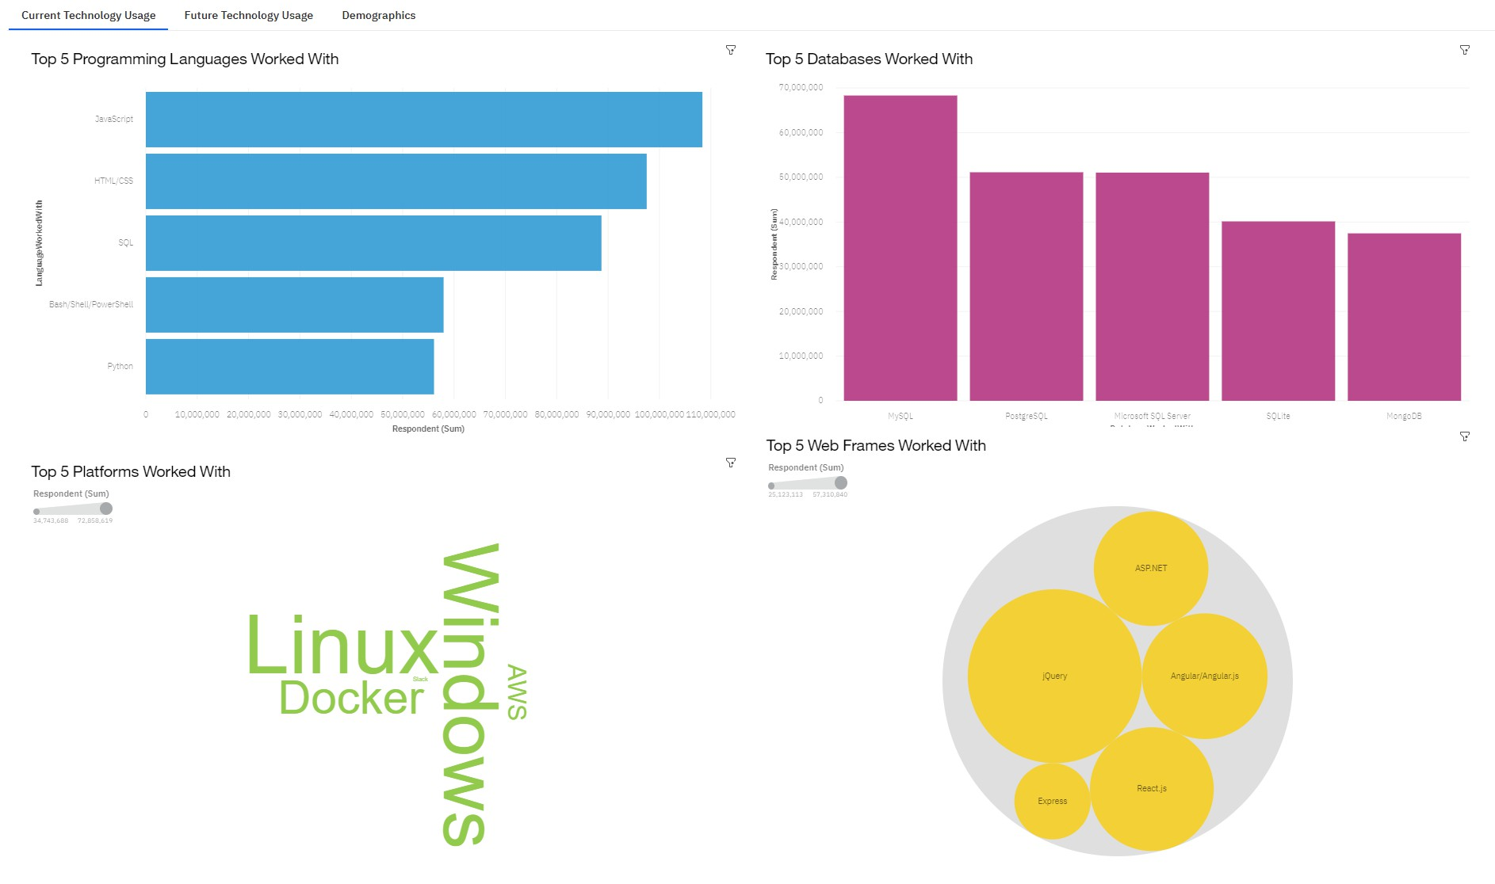
DASHBOARD TAB 1

Slide 17
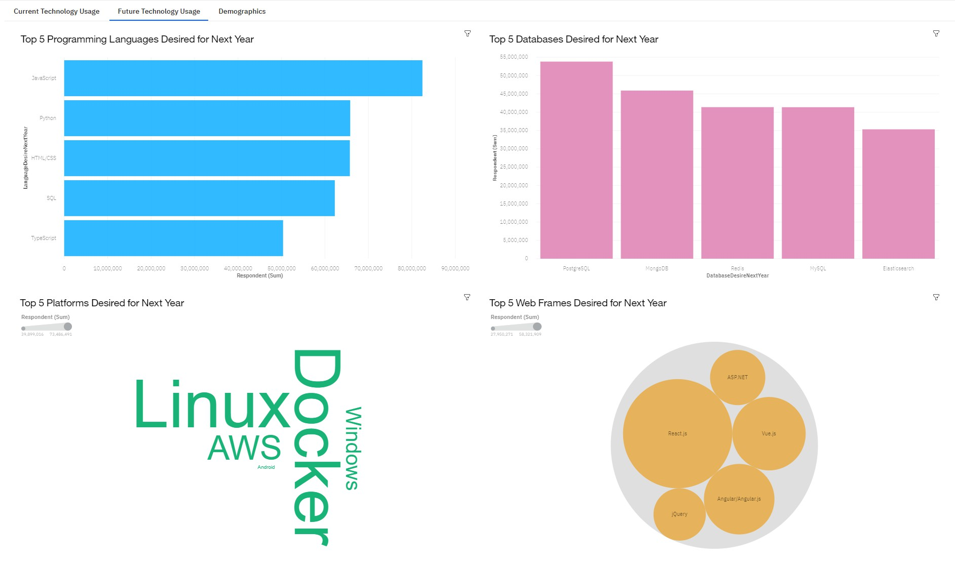
DASHBOARD TAB 2

Slide 18
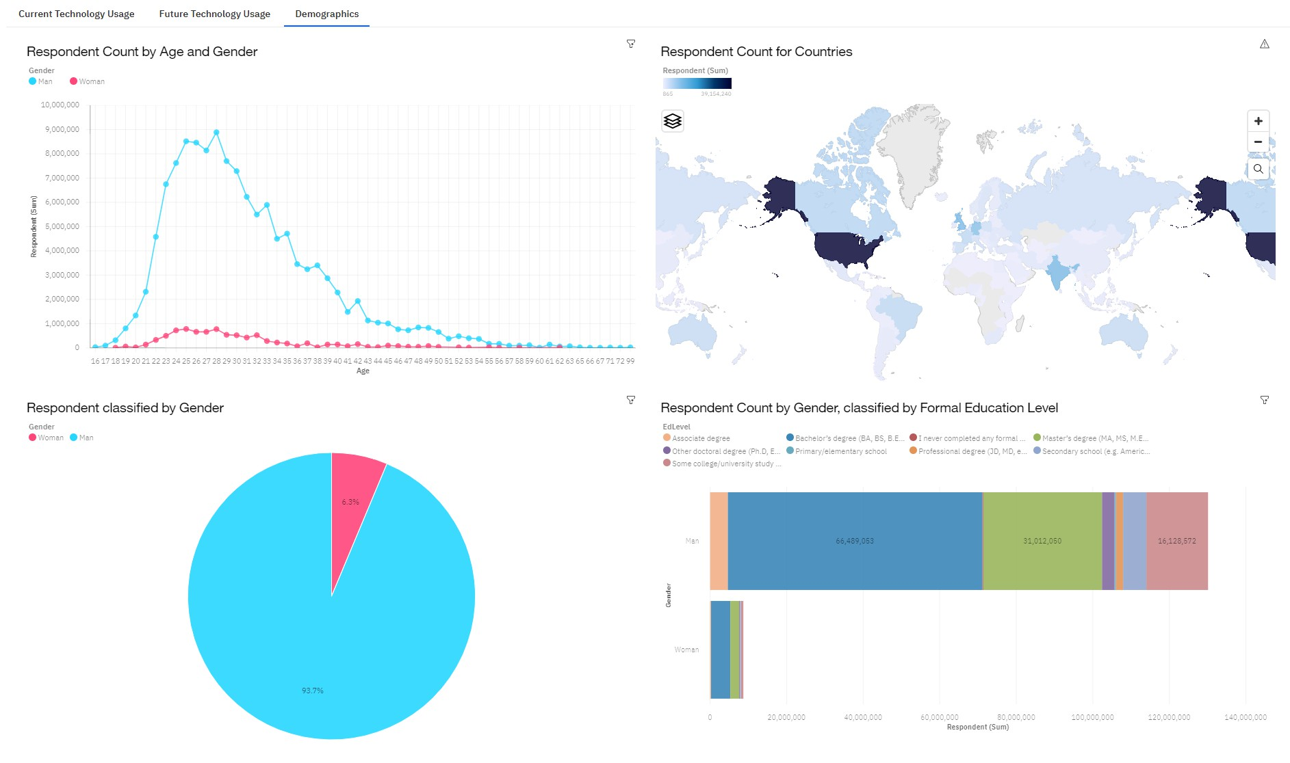
DASHBOARD TAB 3

Slide 19
DISCUSSION
New technology constantly emerges leading to changes in demand
The IT indu.stry needs to diversify in order to eliminate gender gap.

Slide 20
OVERALL FINDINGS & IMPLICATIONS
Findings
Trends and demands fluctuate based on new technologies.
JavaScript and Python are the most popular programming languages.
PostgreSQL is the most popular database.
Gender gap in the IT field.
Implications
IT professionals and companies have to learn and adapt to new demands.
Having skills that are high in demand leads to more job opportunities.
Gender gap will affect job hiring trend.

Slide 21
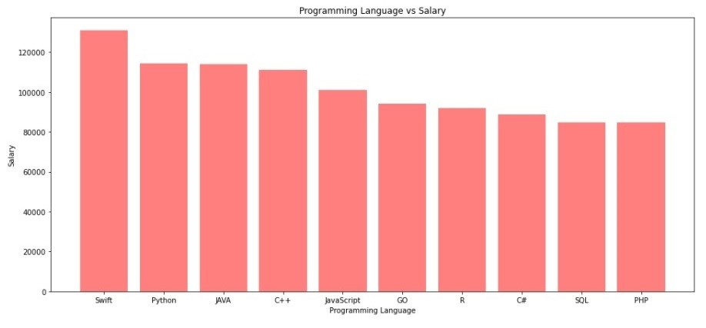
JOB POSTINGS

Slide 22
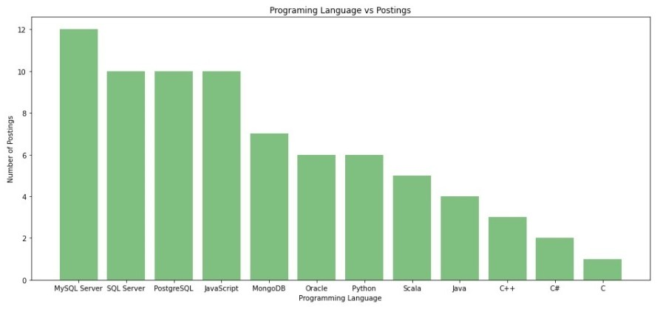
POPULAR LANGUAGES

Slide 23

CONCLUSION
New technology leads to different trends and demands.
JavaScript and Python are the most popular programming languages.
PostgreSQL is the most popular database.
The IT industry needs to diversify.

Slide 24
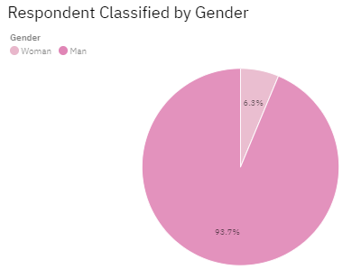

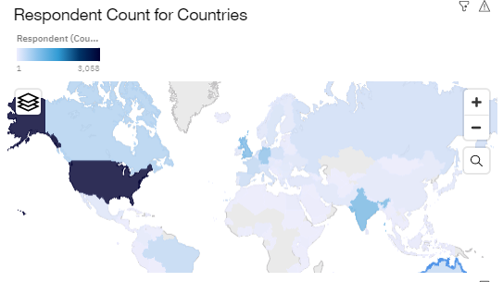
APPENDIX

